Slide 1
CS4015 - Computer Networks Project Presentation
01

Slide 2
Introduction
03
The title of our project is “Implementation of a Hybrid Computer Network Topology with VLAN Support”.
The aim is to design and implement a network topology for a medium-sized company that has different departments requiring both wired and wireless connections.
The network has data security, manages traffic efficiently, and is scalable for future expansions.
We have employed a combination of switches, routers, access points, and PCs to create a hybrid topology integrating VLANs for enhanced security and efficiency

Slide 3
Network Design
04
Our network mainly has 3 VLANs, and a central Multilayer Switch that connects them.
VLAN 1 consists of two PCs connected wirelessly through WRT300N Wireless Router.
VLAN 2 has one PC connected via Ethernet cable ensuring high-speed data transfer for tasks requiring substantial bandwidth. We can say it is the Admin Side.

Slide 4
Network Design
05
VLAN 3 is designed for guests or mobile users connecting wirelessly through an Access Point.
A 3560 Multilayer Switch is central in managing the traffic between different VLANs ensuring efficient data flow and security.

Slide 5
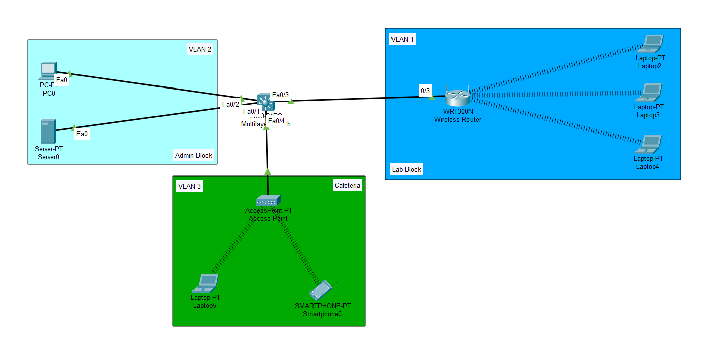
Topology Diagram
06

Slide 6
Setting Up Multilayer Switch
07
While setting up the multilayer switch, we have configured the VLAN names and IP Addresses.
We have also enabled DHCP IP Addressing so that the end devices can get their IP Addresses automatically.
We have also enabled DHCP IP Addressing so that the end devices can get their IP Addresses automatically.

Slide 7
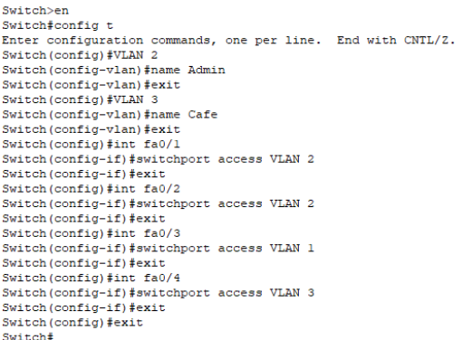
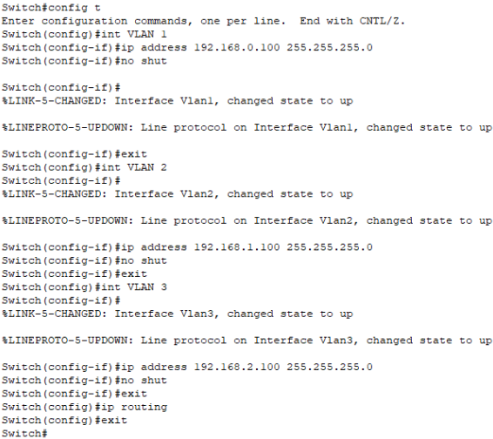
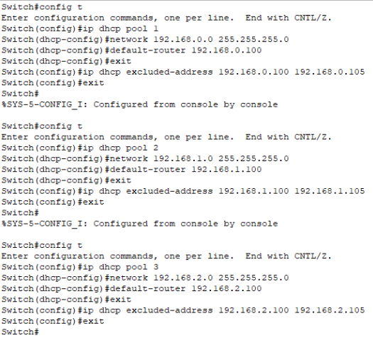
Setting Up Multilayer Switch
08

Slide 8
VLAN 1: Setting Up Wireless Router
09
In setting up the wireless router, first configure the network it will work on.
Next we set up the wireless settings as needed in the router, including the WEP key that the laptops connect through.
DHCP IP Addressing is also enabled here so that the end devices can get their IP Addresses automatically.

Slide 9
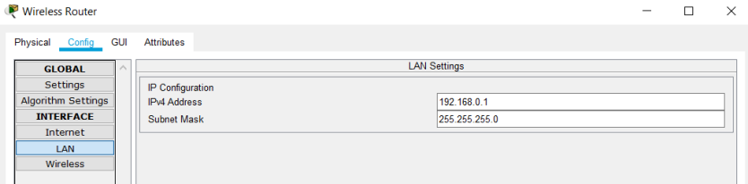
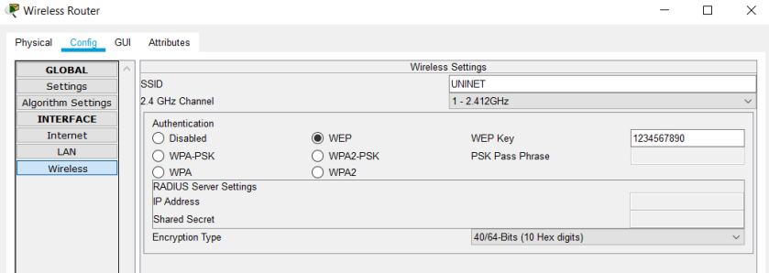
Setting Up Wireless Router for VLAN 1
10

Slide 10
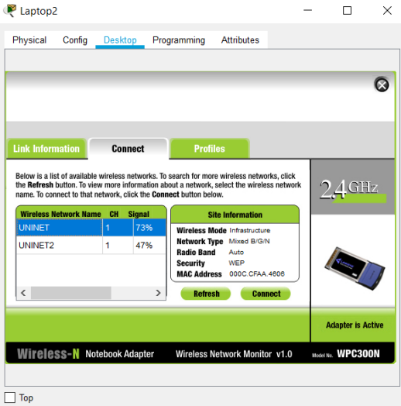
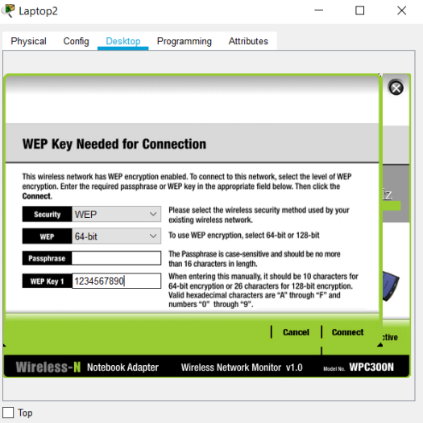
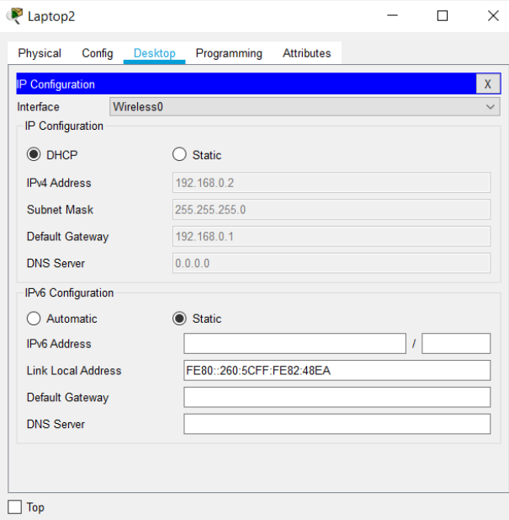
Setting Up Wireless Router for VLAN 1
11

Slide 11
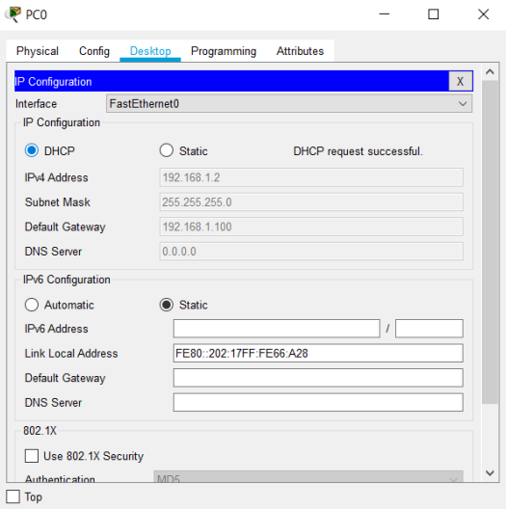
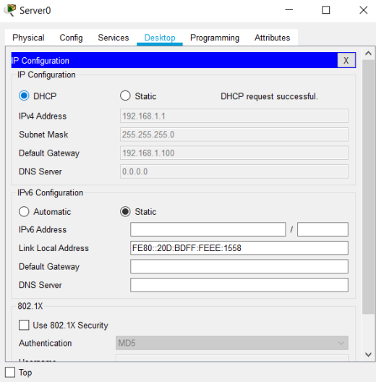
VLAN 2: Setting Up Server and PC
12
In VLAN 2, we just have to connect the PC and Server to the Multilayer Switch and open the option of DHCP IP Address.

Slide 12
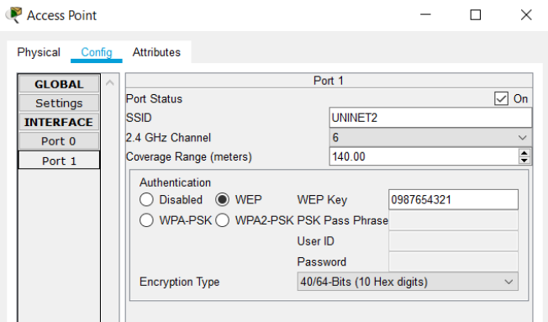
VLAN 3: Setting Up Wireless Access Point
13
For the wireless access point, we configure its port.
We add the options we need, like WEP key, channel amount etc.

Slide 13
VLAN 3: Setting Up the Laptop
14
For the laptop, we go to the wireless configuration, and choose the SSID of the wireless network of the wireless access point.
Next, we add the WEP key for authentication purposes.

Slide 14


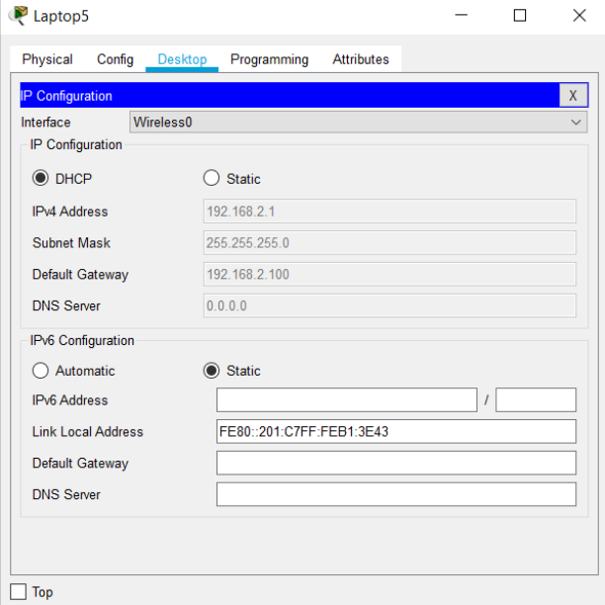
VLAN 3: Setting Up the Laptop
15

Slide 15
VLAN 3: Setting Up the Smartphone
16
For the smartphone, we similarly go to the wireless configuration, and choose the SSID of the wireless network of the wireless access point.
We also add the WEP key for authentication purposes.

Slide 16
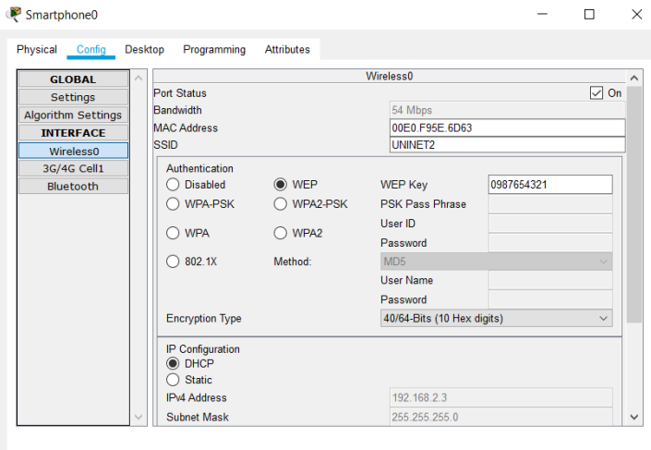
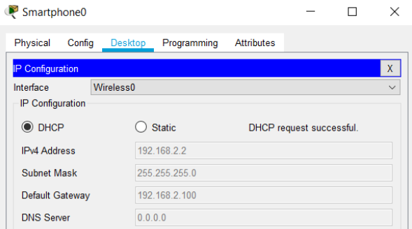
VLAN 3: Setting Up the Smartphone
17

Slide 17
Checking the Network By Sending Packets
18
After we have completely configured all parts of the network, we try to check its functionality through sending packets from one device to another.
We send packets in Simulation and in Real-Time.

Slide 18
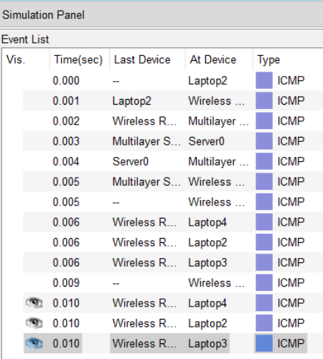
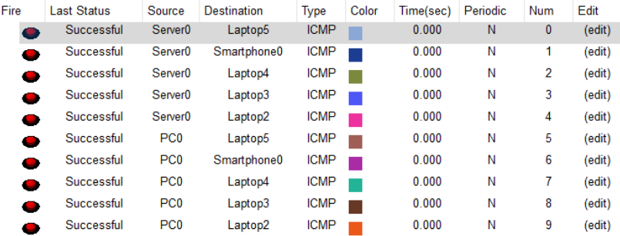
Checking the Network By Sending Packets
19

Slide 19
Conclusion
20
We have created a network in Cisco Packet Tracer.
This network uses the concepts of wireless networking, multilayer switching, and DHCP IP Addressing.
We have learned how to connect devices wirelessly, and how to assign IP Addresses automatically to end devices.
We have also learned how to make the network secure when wirelessly connecting devices.

Slide 20
Thank You
21

